Slide 1
Ch.4 Capturing the requirements

Slide 2
4.1 the requirements process
Requirement
  An expression of desired behavior.
  The goal of the requirements phase is to understand the customer’s problems and needs.
  The requirements focus on the customer and the problem, not on the solution or the implementation

Slide 3
4.1 the requirements process
Requirement specification phase
  During the specification phase, we will decide which(what) requirements will be fulfilled by our system.
System design phase
  During the design phase, we will devise a plan for how the specified behavior will be implemented.

Slide 4
Process for capturing the requirements
Elicitation: Elicit the requirements
  By asking questions, examining current behavior, or demonstrating similar systems.
Analysis: Capture the requirements in a model or a prototype
Specification: Specify the requirements
Validation: Validate the requirements
Process for Capturing Requirements: Figure 4.1,P144

Slide 5
4.2 Requirements elicitation(导出)
Some difficulty about Requirements elicitation
  To understand a completely new problem
  Customers are not always good ay describing exactly what they want or need;
  we (developers) are not always good at understanding someone else’s business concerns.
  It is difficult to discuss the requirements with everyone who has a stake（利害关系） in the system，and coalesce(合并) these different views in to a coherent set of requirements.

Slide 6
People(stakeholders) who contribute to the requirements
Clients(项目委托)
  pay for the software to be developed.
Customers(购买软的客户)
  buy the software after it is developed
Users(使用系统的人)
Domain experts(领域专家)
  familiar with the problem that the software must automate

Slide 7
People(stakeholders) who contribute to the requirements
Market researchers
  conduct surveys to determine future trends and potential customers
Lawyers or auditors(审计人员)
  familiar with government, safety, or legal requirements
Software engineers or technology experts
  Theses experts ensure that the product is technically and economically feasible(可行).

Slide 8
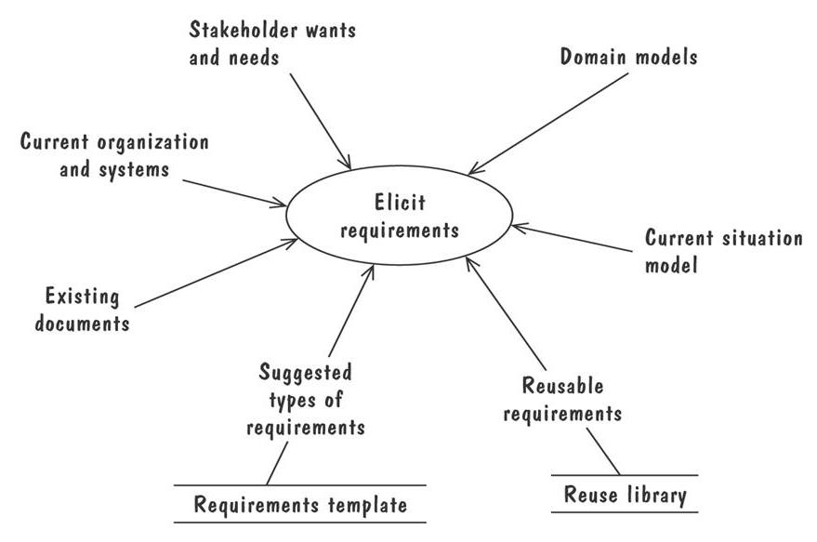
some additional sources for requirements

Slide 9
4.3 types of requirements
Functionality
  What service should be provided?
  What operations should be performed?
  What should be the reaction to certain stimuli(事件)?
Functional requirement
  Describes required behavior in terms of required activities.
  Reaction to inputs
  The state of each entity before and after an activity occurs.

Slide 10
Nonfunctional requirement
Nonfunctional requirement (also called quality requirement)
  Describes some quality characteristic that the software solution must process.
  Such as fast response time, ease of use.
Design constraint
  A design decision, such as choice of platform or interface components.比如使用Linux平台.

Slide 11
Nonfunctional requirement
Process constraint
  A restriction on the techniques or resources that can be used to build the system, for example, customers may insist that we use agile methods.
  比如要求使用敏捷方法.
Quality requirements, design constraint, and process constraint further restrict our solution space by differentiating(区别) acceptable, well-liked solutions from unused products.

Slide 12
Resolving conflicts
In trying to elicit all types of requirements from all of the relevant stakeholders, we are bound to encounter conflicting ideas(冲突的想法) of what the requirements ought to be.
Resolving conflicts
  To prioritize requirements
  Separating requirements into three categories
    essential: absolutely must be met
    desirable: highly desirable but not necessary
    optional: possible but could be eliminated

Slide 13
Two kinds of requirements documents
Requirements definition(描述问题，业务)
  A complete listing of everything the customer wants to achieve.
  Describing the entities in the environment.
  Represent a contract describing what functionality the developer promises to deliver to the client.

Slide 14
Two kinds of requirements documents
Requirements specification(描述系统用那样行为满足业务)
  Restate the Requirements definition as a specification of how the proposed system shall behave.
  System boundary makes explicit those environmental entities that can be monitored or controlled by the system.
  This distinction is depicted in Figure 4.3,P155, the requirements definition defined any where within the environment’s domain, and with the requirements specification restricted only to the intersection between the environment and system domains
    需求定义定义环境领域所有实体
    需求规格说明只定义环境和系统领域的交互处
  The requirements specification is written by the requirements analyst and is used by the other software developers.

Slide 15
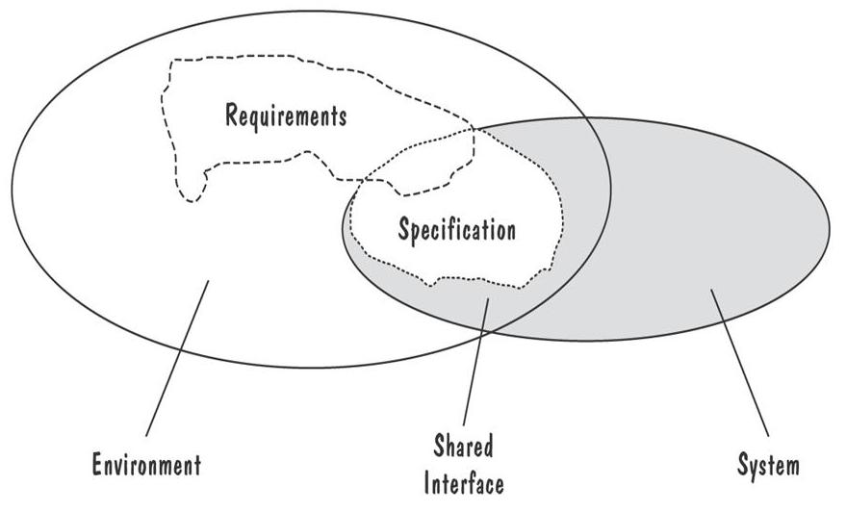
Requirements definition VS. Requirements specification

Slide 16
4.4 characteristics of requirements
Are the requirement correct(正确)?
Are the requirement consistent（一致）?
  Are there any conflicting requirements?
Are the requirements unambiguous(明确)?
Are the requirement complete(完整)?
  Externally complete (if all states, state changes, inputs, products, and constraints are described by some requirement.)
  Internally complete (if there are no undefined terms among the requirements)

Slide 17
4.4 characteristics of requirements
Are the requirement feasible (可行)?
  Dose a solution to the customer’s need even exist?
Is every requirement relevant(相关的)?
  A tank’s new software system should allow soldiers to send and receive electronic mail?
Are the requirements testable(验证)?
Are the requirements traceable(回溯)?
  Are the requirements organized and uniquely labeled for easy reference?

Slide 18
4.5 modeling notations (表示，符号)
It is important to have standard notations for modelling, documenting, and communicating decisions.
Modelling helps us to understand requirements thoroughly
  Holes in the models reveal unknown or ambiguous behaviour
  Multiple, conflicting outputs to the same input reveal inconsistencies in the requirements

Slide 19
4.5 modeling notations (表示，符号)
Entity-Relationship diagrams
UML Class diagram
Message sequence chart
State machines
UML statechart diagrams
Petri Nets
Data-flow Diagrams
Use cases
Decision tables
Parnas tables
Object constraint language
Algebraic specifications

Slide 20
UML Class diagram
UML (Unified Modelling Language) is a collection of notations used to document software specifications and designs.
Because UML was originally conceived for object-oriented system, It represents a system in terms of
  objects: akin to entities, organized in classes that have an inheritance hierarchy.
  methods: actions on the object's variables.

Slide 21
UML Class diagram
The class diagram is the flagship model in any UML specification
  A sophisticated ER diagram relating the classes (entities) in the specification
  A conceptual modeling notation, in which classes represent real-world entities in the problem to be modeled.

Slide 22
UML Class diagram
In UML class diagram, each box is a class, a class has a name, a set of attributes, and a set of operations(methods).
A class-scope attribute(类成员，静态变量) represented as an underlined attribute, is a data value that is shared by all instances of the class.
A class-scope operation（类方法） written as underlined operation, is an operation performed by the abstract class rather than by class instances

Slide 23
Relationships between classes
An association(关联关系), marked as a line between two classes, indicates a relationship between classes‘ entities.
An association may represent interactions or events that involve objects in the associated classes, such as when a patron borrows a publication.
When the association need to be described, we use association class(关联类) to relate attributes and operations for an association.
Association classes are used to collect information that can not be attributed solely to one class or another.

Slide 24
Relationships between classes
Aggregate(聚合关联) association is a kind of “has-a” relationship, which is drawn as an association with a white diamond on the end.
Composition(合成关联) association is a special type of aggregation, in which instances of the compound class are physically constructed from instances of the component classes (e.g. a bike consists of wheels, gears, pedals, a handlebar) , it is represented as an aggregation with a black diamond.

Slide 25
Relationships between classes
A generalization association is a sub-type relation or an “is-a” relation, it is drawn as an association with a triangle on the end.
An end of an association can be label, to describe the role that entity plays in the association, called role name.
Association ends can also be annotated with multiplicities(多重性), which specify constraints on the number of entities.

Slide 26
Message Sequence Chart(sequence diagram)
Event Traces
  A graphical description of a sequence of events that are exchanged between real-world entities
    Vertical line: the timeline of distinct entity, whose name appear at the top of the line
    Horizontal line: an event or interaction between the two entities bounding the line
    Time progresses from top to bottom
  Each graph depicts a single trace, representing one of several possible behaviours
  Traces have a semantic that is relatively precise, simple and easy to understand

Slide 27
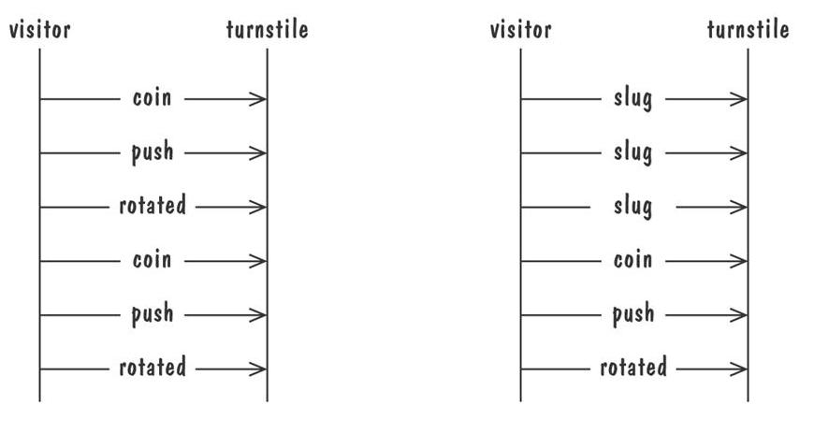
Event Traces
Graphical representation of two traces for the turnstile(十字转门) problem
  trace on the left represents typical behaviour
  trace on the right shows exceptional（击打，使劲推门） behaviour

Slide 28
Message Sequence Chart(sequence diagram)
Message Sequence Chart
  An enhanced event-trace notation, with facilities for creating and destroying entities, specifying actions and timers, and composing traces
    Vertical line represents a participating entity
    A message is depicted as an arrow from the sending entity to the receiving entity
    Actions are specified as labelled rectangles positioned on an entity's execution line
    Conditions are important states in an entity‘s evolution, represented as labelled hexagon（六角形）

Slide 29
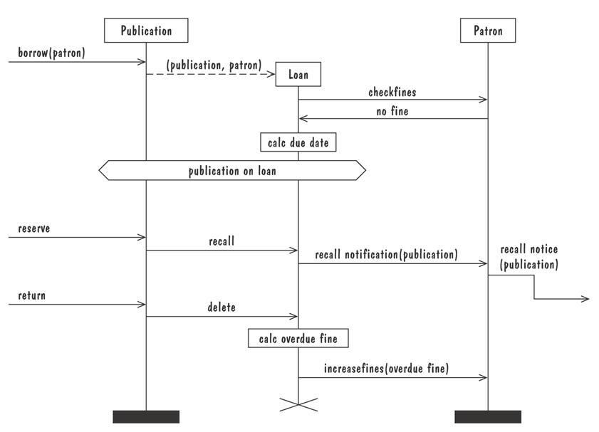
Message sequence chart for library loan transaction

Slide 30
UML State chart Diagrams
A UML state chart diagram depicts the dynamic behaviour of the objects in a UML class
  UML class diagram has no information about how the entities behave, how the behaviours change
UML state chart diagram have a rich syntax, including state hierarchy, concurrency, and intermachine communication
Node (state) represents a stable set of conditions that exists between event occurrences
Edge (transition) represents a change in behaviour or condition due to the occurrence of an event

Slide 31
UML State chart Diagrams
State hierarchy is used to unclutter（整理） diagrams by collecting into super state those states with common transitions
A super state can actually comprise multiple concurrent submachines, separated by dashed line
  The submachines are said to operate concurrently

Slide 32
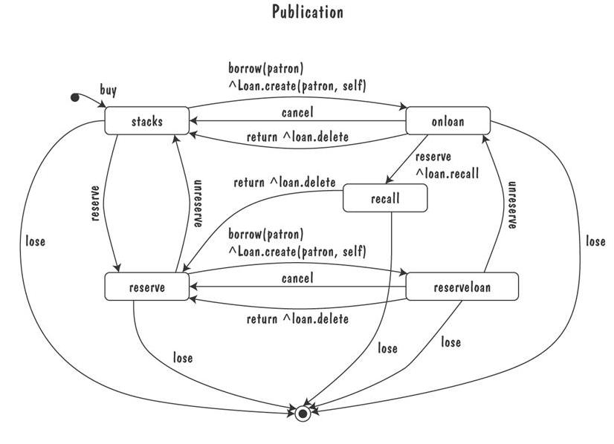
Messy UML statechart diagram for publication class

Slide 33
Use Cases diagram
Components
  A large box: system boundary
  Stick figures outside the box: actors, both human and systems
  Each oval inside the box: a use case that represents some major required functionality and its variant
  A line between an actor and use case: the actor participates in the use case
Use cases do not model all the tasks, instead they are used to specify user views of essential system behaviour

Slide 34
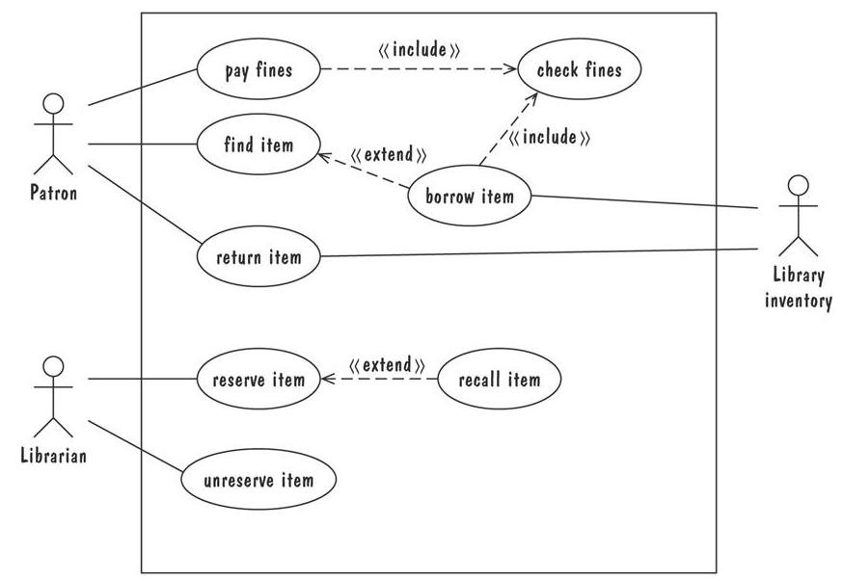
Use Cases

Slide 35
4.6 requirements and specification languages
There are many types of software models in software-engineering community, and each of notational paradigms described problems from a different perspective. So, a complete specification may consist of several models, each of which illustrates a different aspect of the problem. Most practical requirements and specification languages are actually combinations of several notational paradigms.

Slide 36
4.6 requirements and specification languages
The Unified Modeling Language standard comprises eight graphical modeling notations. There are five are used in requirements analysis phase:
  Use case diagram
  class diagram
  sequence diagram
  collaboration diagram
  statechart diagram.

Slide 37
4.7 prototyping requirement
To elicit the details of proposed system
To solicit feedback from potential users about
  what aspects they would like to see improve
  which features are not so useful
  what functionality is missing
Determine whether the customer's problem has a feasible solution
Assist in exploring options for optimizing quality requirements

Slide 38
4.7 prototyping requirement
A throw-away prototype
  Software developed to learn more about a problem or explore the feasibility or desirability of possible solutions. It is exploratory, and it is not intended to be used as an actual part of the delivered software
A evolutionary prototype
  Is developed to learn about a problem and form the basis for some or all of the delivered software
Rapid prototyping
A example figure 4.23 – 4.25, P192.

Slide 39
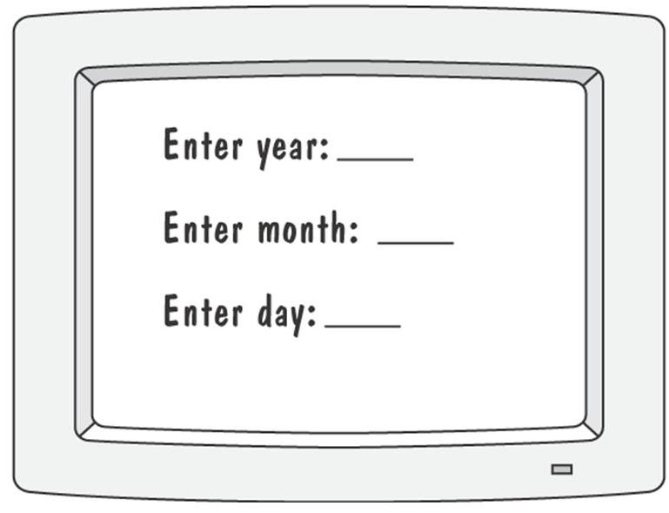
An example of prototyping
Prototype for building a tool to track how much a user exercises each day
Graphical representation of first prototype, in which the user must type the day, month and year

Slide 40
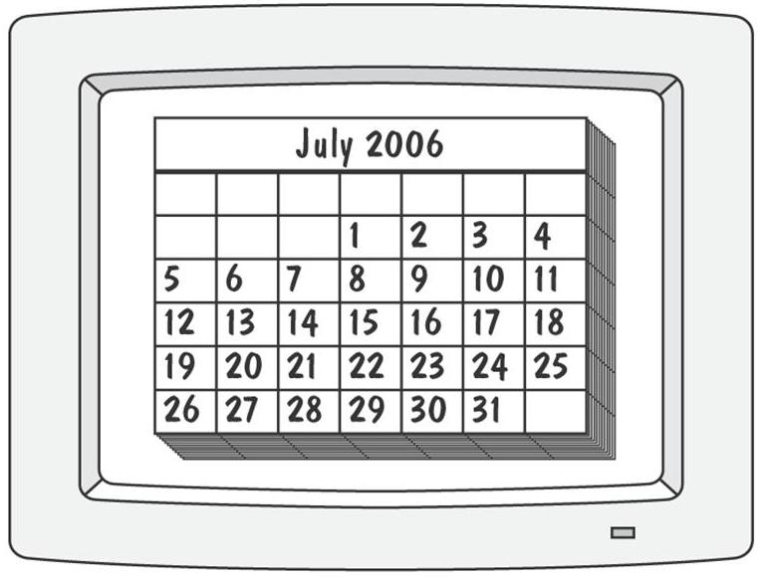
An example of prototyping
Second prototype shows a more interesting and sophisticated interface involving a calendar
  User uses a mouse to select the month and year
  The system displays the chart for that month, and the user selects the appropriate date in the chart

Slide 41
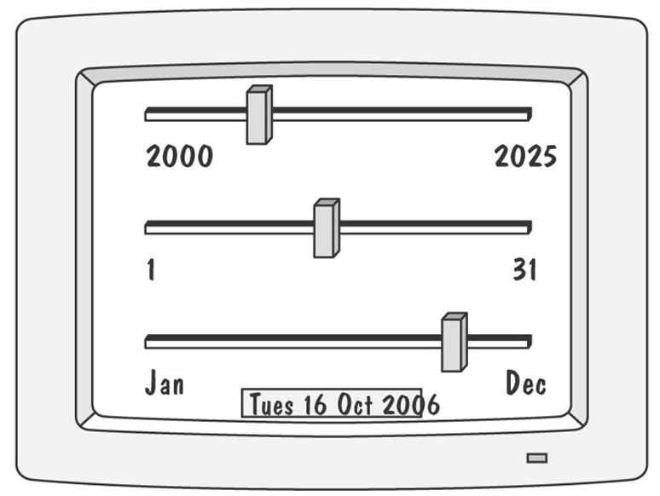
An example of prototyping
Third prototype shows that instead of calendar, the user is presented with three slide bars
  User uses the mouse to slide each bar left or right
  The box at the bottom of the screen changes to show the selected day, month, and year

Slide 42
4.8 requirement documentation
A set of documents need to be created for recording requirement result.
Requirements definition document
  expressed in customer’s terms
  Outline the general purpose of the system
  Describe the background and the rationale behind the proposal for a new system
  Describe the essential characteristics of an acceptable solution
  Describe the environment in which the system will operate
  If the customer has a proposal for solving the problem, we outline a description of the proposal
  We list any assumptions we make about how the environment behaves.

Slide 43
4.8 requirement documentation
Requirement specification document
  Written from the developer's perspective
  In documenting the system’s interface, we describe all inputs and outputs in detail.
  Restate the required functionality in terms of the interfaces’ inputs and outputs
  We devise fit criteria for each of the customer’s quality requirements.
  An example in Figure 4.26,P197

Slide 44
Process management and requirements traceability
Process management is a set of procedures that track
  the requirements that define what the system should do
  the design modules that are generated from the requirement
  the program code that implements the design
  the tests that verify the functionality of the system
Process management provides the threads that tie the system parts together.

Slide 45
4.9 validation and verification
In requirements validation, we check that our requirements definition accurately reflects the customer's needs
In verification, we check that one document or artifact conforms to another
Verification ensures that we build the system right, whereas validation ensures that we build the right system

Slide 46
4.9 validation and verification
requirements validation
  We check that our requirements definition accurately reflects the customer’s needs.
  Reading documents
  Walkthrough
  Formal inspection
  review
requirements verification
  We check that one document or artifact conforms to another.
  Check requirements-specification document corresponds to requirements-definition document

